Slide 1
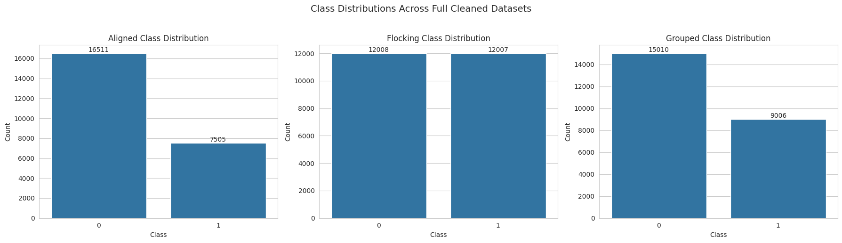
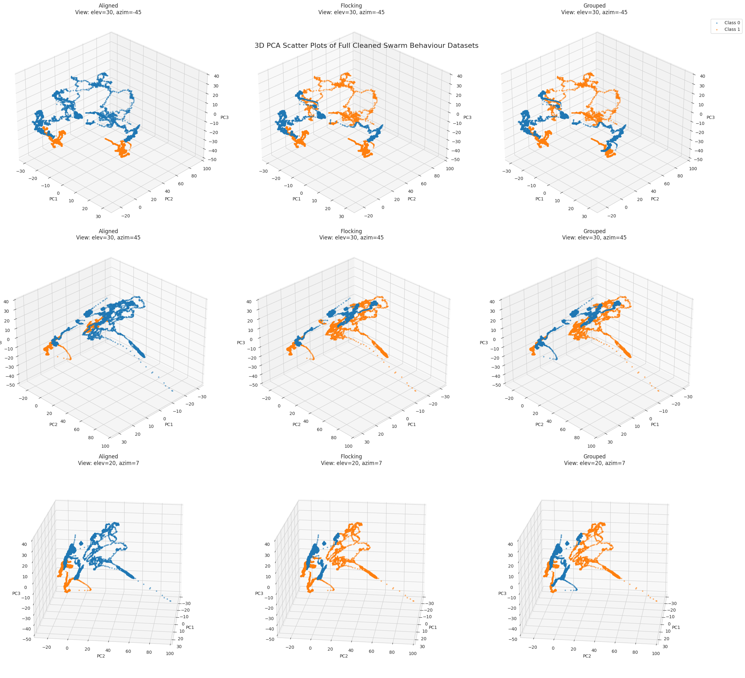
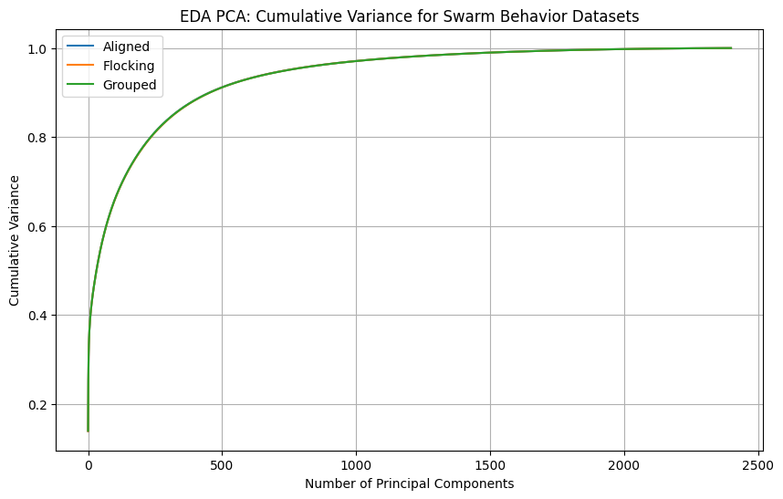
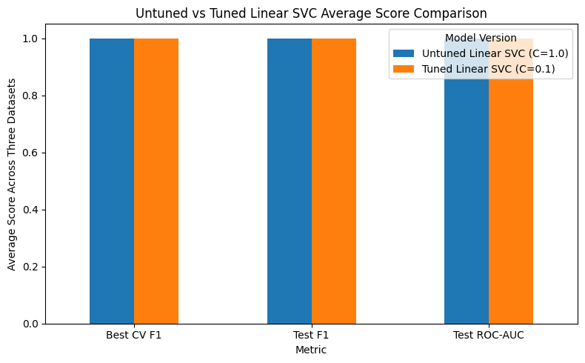
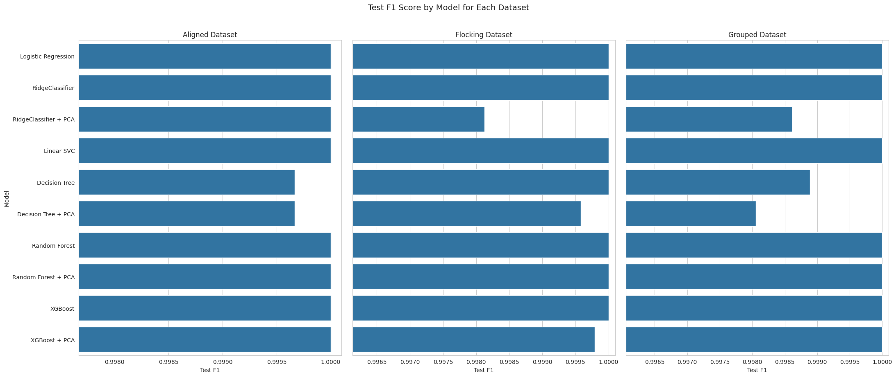
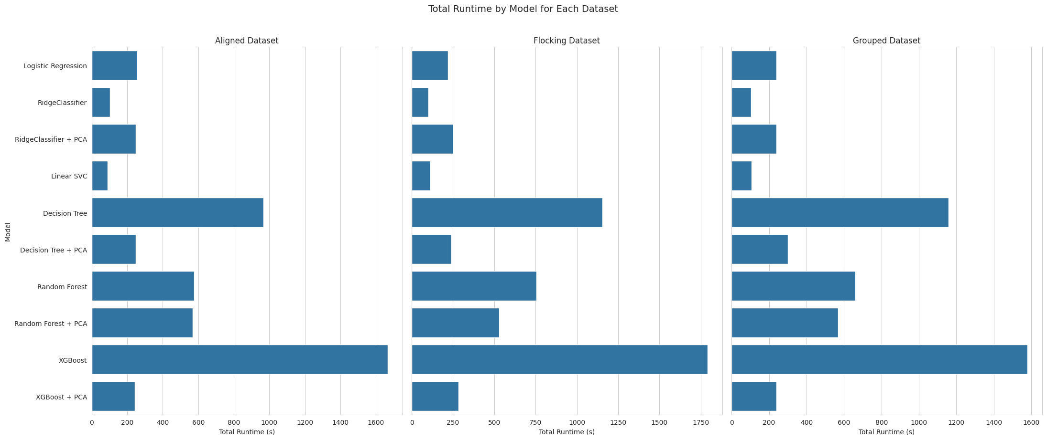
Swarm Behavior Daniel Sanchez Eastern New Mexico University 2026 Daniel.R.Sanchez@enmu.edu
Introduction
Results
Conclusion
This project aims to identify the most efficient and accurate supervised machine learning model for classifying high-dimensional swarm behavior data. Using the UCI Swarm Behavior datasets, the project compares models across three binary classification tasks: aligned/not aligned, flocking/not flocking, and grouped/not grouped. Dimensionality reduction techniques, including PCA, were explored in an attempt to improve model performance and runtime. However, simpler models without dimensionality reduction were found to be more effective overall because the datasets were highly separable in their original feature space.
The results showed that the Swarm Behavior datasets were highly separable in the original feature space. Several models achieved near-perfect or perfect held-out test performance, so final model selection depended on both predictive accuracy and total runtime. Linear SVC was selected as the final model because it achieved perfect Test F1 and ROC-AUC across all three datasets while requiring lower total runtime than other models. RidgeClassifier also performed very well, but Linear SVC provided the best overall balance of test performance and runtime. PCA-based dimensionality reduction did not improve performance enough to change the final model selection. The untuned Linear SVC baseline also performed nearly identically to the tuned version, showing that hyperparameter tuning mainly validated Linear SVC rather than improving its predictive performance.
Methodology
Datasets: This project used three files from the UCI Swarm Behavior dataset: Aligned, Flocking, and Grouped. Each dataset represents a separate binary classification task where the Class column identifies whether the swarm behavior is present or absent. After cleaning, the Aligned dataset contained 24,016 rows and 2,401 columns, the Flocking dataset contained 24,015 rows and 2,401 columns, and the Grouped dataset contained 24,016 rows and 2,401 columns. Each dataset included 2,400 numerical predictor features and one binary target column. Preprocessing:
All predictor variables represented numerical swarm-movement measurements, so one-hot encoding was not required. The datasets were inspected to verify that the feature columns were stored as numeric values, column names were cleaned, and missing or malformed values were checked. Only the Flocking dataset contained a missing/malformed row, so that row was removed before modeling.. Training and Testing: Each dataset was split into an 80% training set and a 20% held-out test set. Stratified sampling was used because the datasets had different class distributions, especially Aligned and Grouped, which were more imbalanced than Flocking. This helped preserve the original class proportions in both the training and testing sets. Scaling and Dimensionality Reduction: Appropriate scaling was applied for scale-sensitive models and PCA-based pipelines. PCA analysis showed that a large number of components was required to retain most of the dataset variance. Approximately 455 components were needed for 90% variance, about 740 components for 95% variance, and about 1,504 components for 99% variance. PCA settings of 95% explained variance, 50 components, and 100 components were tested to determine whether dimensionality reduction improved runtime or performance. Model Training and Evaluation: EDA suggested that the datasets were high-dimensional but highly separable. Because of this, computationally efficient linear models were tested alongside more complex models. The project compared Logistic Regression, RidgeClassifier, Decision Tree, Linear SVC, Random Forest, XGBoost, and selected PCA variants. Models were tuned using cross-validation and evaluated using F1-score, ROC-AUC, accuracy, precision, recall, confusion matrices, and runtime. Since multiple models achieved perfect or near-perfect held-out test results, runtime efficiency became an important final selection factor.
Future Work
Future work could explore additional classification models and alternative modeling strategies to determine whether similar predictive performance can be achieved with lower total runtime. Since Linear SVC already performed extremely well, the next step would not only be to improve accuracy, but to investigate whether another method could match the same F1-score and ROC-AUC while training or running faster. Future work could also test different feature-selection methods, dimensionality-reduction techniques, or reduced feature sets to see whether fewer boids or fewer movement variables can still produce strong classification results. This may help identify a smaller set of important swarm-movement features while reducing model complexity. Additional experiments could also compare different hyperparameter search methods, such as randomized search or more efficient optimization strategies, to reduce tuning time. Finally, the model could be tested on new swarm simulations to determine whether the same performance holds beyond the current UCI Swarm Behavior datasets.
References
Swarm Behaviour [Dataset]. (2020). UCI Machine Learning Repository. https://doi.org/10.24432/C5N02J

